Slide 1
Advanced Computational Methods in Geotechnical Engineering
Lecture
June 20, 2008

Slide 2
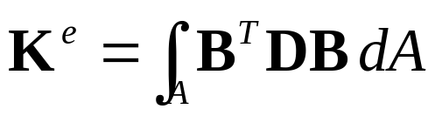
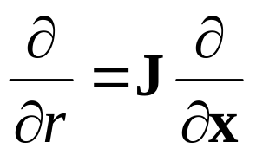
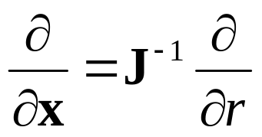
- In our last class we discussed:
Formulation of FE equation:
- Variational Approach
Assuming equilibrium along the total length of the bar.
Minimize the total energy in the bar with respect to the nodal displacements.

Slide 3
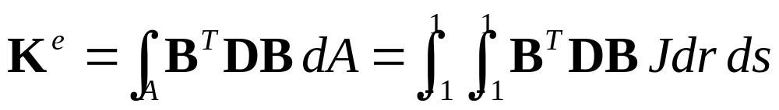
6.2 Numerical Integration
(Good Reference: Chapter 5 of FE Procedures, K.J. Bathe)
All FE calculations involve integration through the element of functions of the shape functions.
For all but the simplest of elements, this integration would be very complex if attempted analytically, so it is common in FE calculations for the integration to be done numerically.

Slide 4
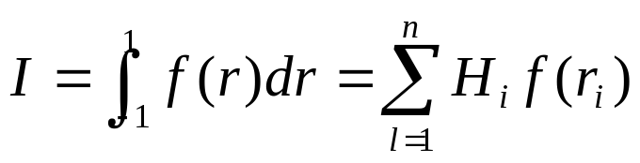
The fastest and most accurate method is the Gaussian quadrature (a.k.a Gauss-Legendre) numerical integration. But this technique requires the limits of integration to be (0,1) or (-1,1).
This is exactly the range available in an element defined in terms of its natural coordinate system.
In numerical integration techniques, the integral is approximated by the sum of values of the integrand at a number of points (sampling points) multiplied by factors known as weights.
H_{i} – weight functions associated with i ^{th} point
r_{i} – sampling points, n is the number of sampling points.

Slide 5
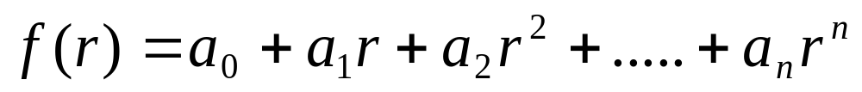
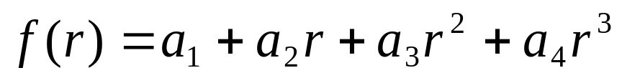
In the Gauss method, the function f (r ) is approximated by a polynomial expression of the form:
The principle involved in deriving Gauss quadrature formula can be illustrated by considering a simple function (Text, pp. 150):

Slide 6
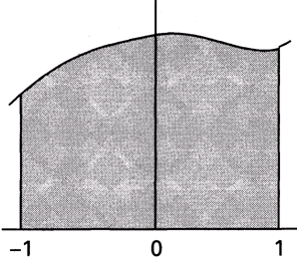


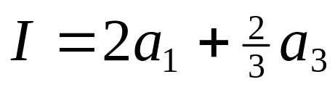
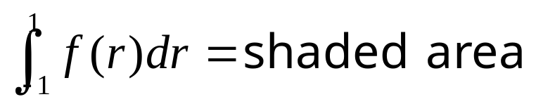
The Gauss method evaluates the function to be integrated at a number of sampling points, multiplying these values by weighting functions and summing the products.
If f(r) is integrated between -1 and 1, the area under the curve is given by:

Slide 7

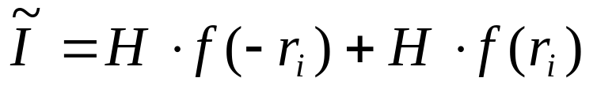

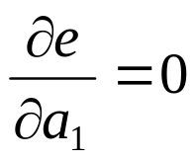
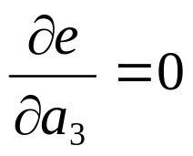
By using two symmetrically located points the area can numerically be approximated as:
=
2
H
⋅
(
a
+
a
r
2
)
1
3
i
If we want to minimize the error for any values of a₁ and a₃, we must have:

Slide 8

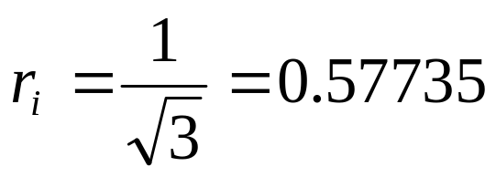
These equations give:
And:

Slide 9
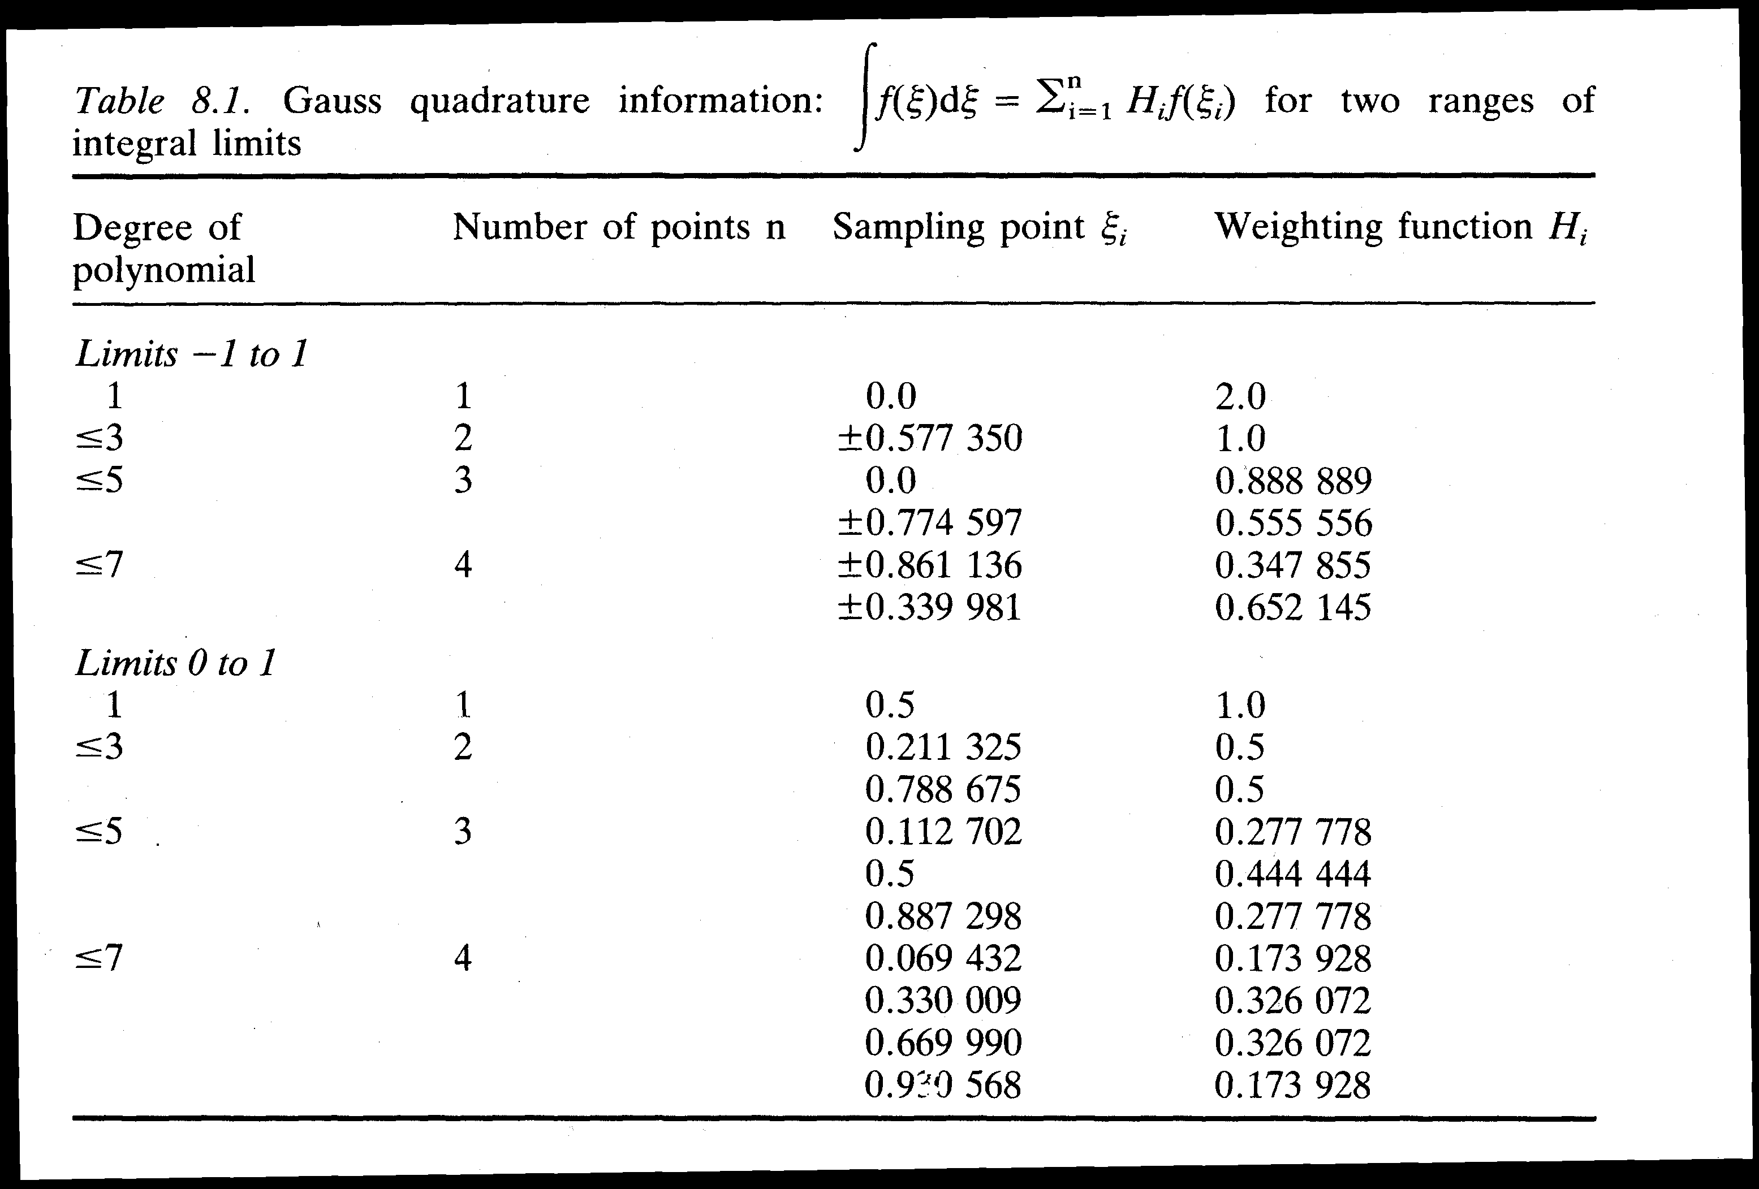









Table: Sampling points and weights in Gaussian integration
The Gauss Method is exactly accurate for n sampling points on a polynomial of order 2n-1 or less.

Slide 10
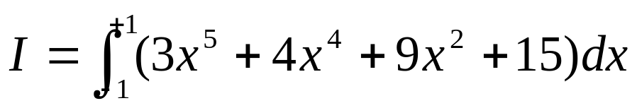

Example: solve the following integral using Gauss quadrature method with 3 sampling points.
r_{i} f(r_{i}) H_{i} H_{i} f(r_{i})
-0.774597 21.003441 0.555556 11.668588
0.000000 15.000000 0.888889 13.333335
0.774597 22.676573 0.555556 12.598106
I = 37.600029

Slide 11
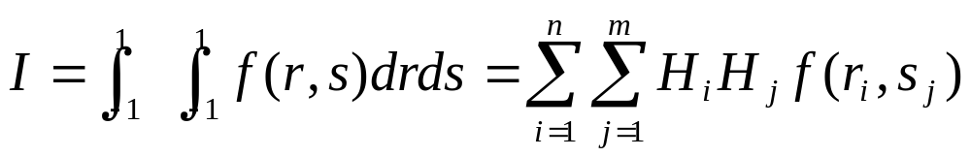
Numerical Integration in 2D
So far we have considered the integration of a 1D function f(r). In two-dimensional (rectangular) regions, we obtain the Gauss quadrature formula by integrating first with respect to one coordinate and then with respect to the second as:

Slide 12
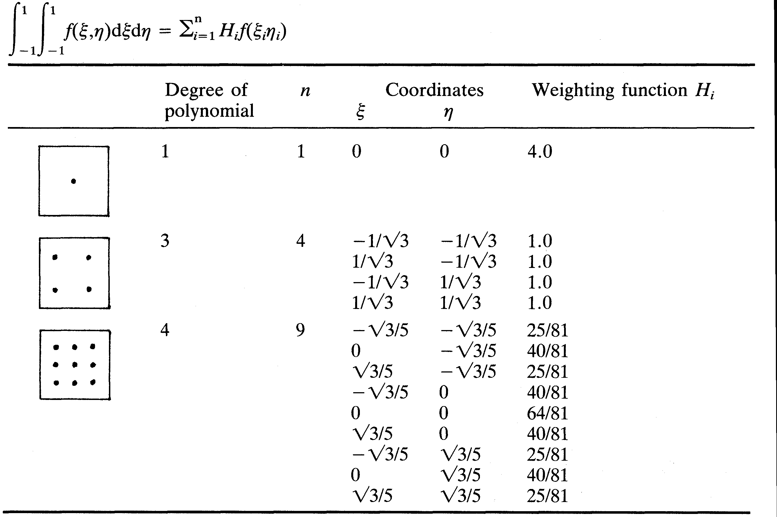


Table: Sampling points and weights in 2D Gaussian integration
(rectangular regions).
Generally:
4 sampling points are used for a 4-noded element.
9 sampling points are used for a 8-noded element.

Slide 13


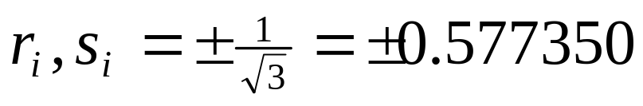
For example, a 4 – point Gaussian rule gives:
Where the four sampling points are located at

Slide 14
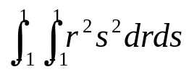
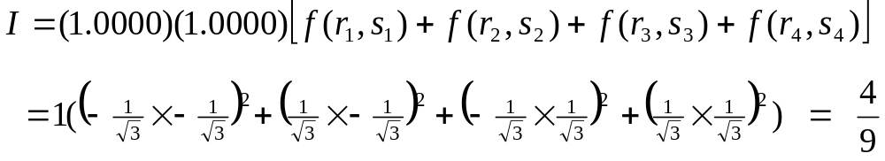
EXAMPLE:
Given the (i,j)^{th} element of a stiffness matrix K is
evaluate the integral using the Gauss quadrature method with 4 sampling points.

Slide 15
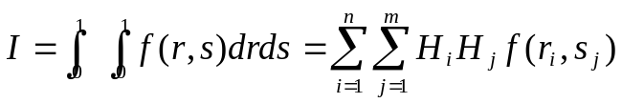
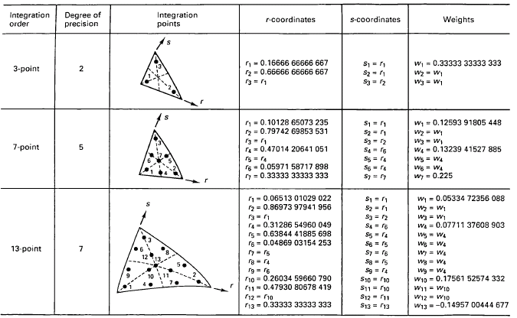
Table: Sampling points and weights in 2D Gaussian integration
(triangular regions, Bathe, pp. 467/pdf-130).

Slide 16
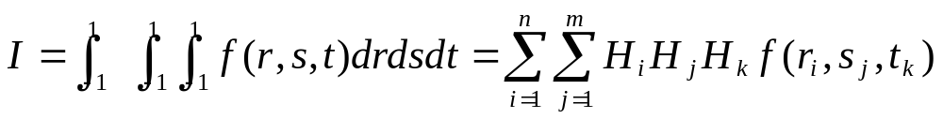
Similarly the integration formula for 3D is given by:

Slide 17
7 Assembly of Element Matrices & Vectors
Once the element matrices & vectors are found, the next step is to obtain the characteristic equations of the entire system by assembling the element matrices & vectors.
The procedure of assembling the element matrices & vectors is the same regardless of the type of problem and the number and types of elements used.
The procedure of assembling the element matrices & vectors is based on the requirement of compatibility at the element nodes. This means that at the nodes where elements are connected, the values of the unknown nodal degrees of freedom (eg. displacements) are the same for all the elements joining at that node.

Slide 18
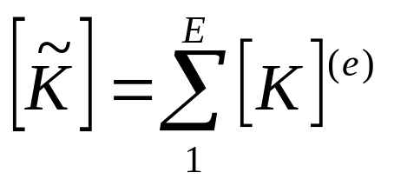
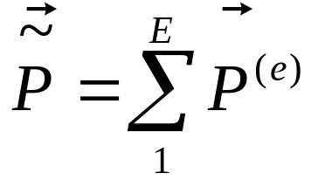
When the displacements are matched at a common node, the nodal stiffness and nodal loads of each of the elements are added to obtain the net stiffness & the net load at that node.
Global matrix:
E = total number of elements.
Global load vector:

Slide 19
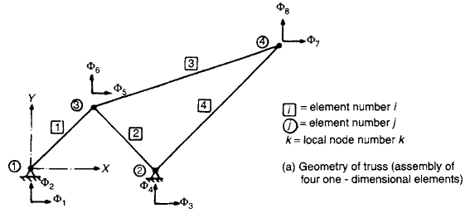
node
global
FIGURE: A planar truss as an assembly of 1D elements

Slide 20
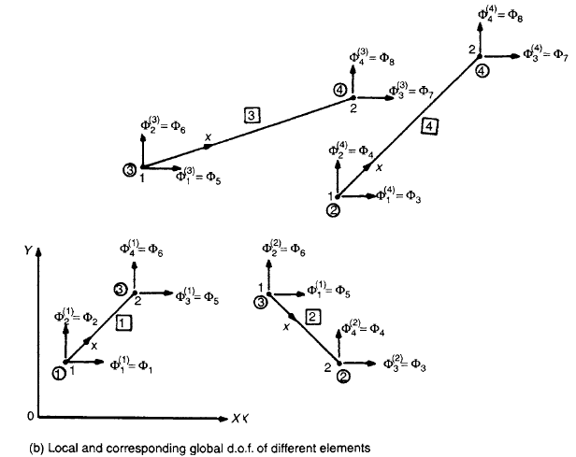
Text, pp. 212
Local & corresponding global d.o.f. (each element has 4 d.o.f.)

Slide 21
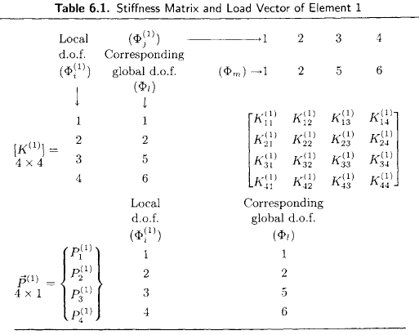
Stiffness Matrix and Load Vector of Element 1

Slide 22
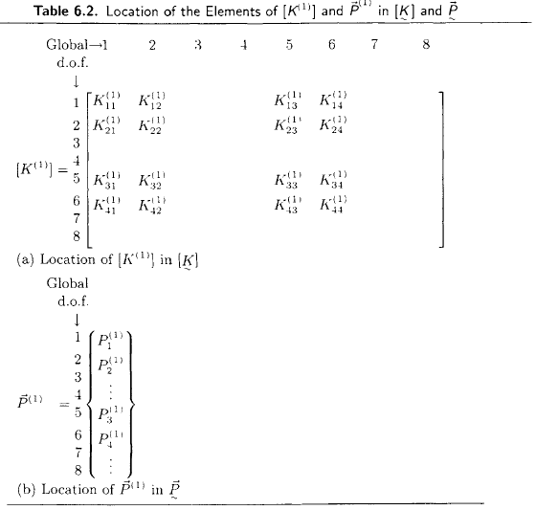
~
~
Location of element [K⁽¹⁾] & P⁽¹⁾ in global [K] and P

Slide 23
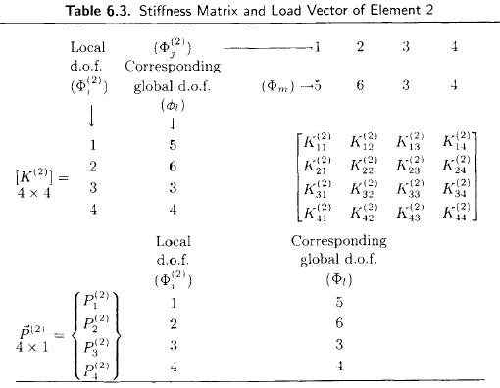
Stiffness Matrix and Load Vector of Element 2

Slide 24
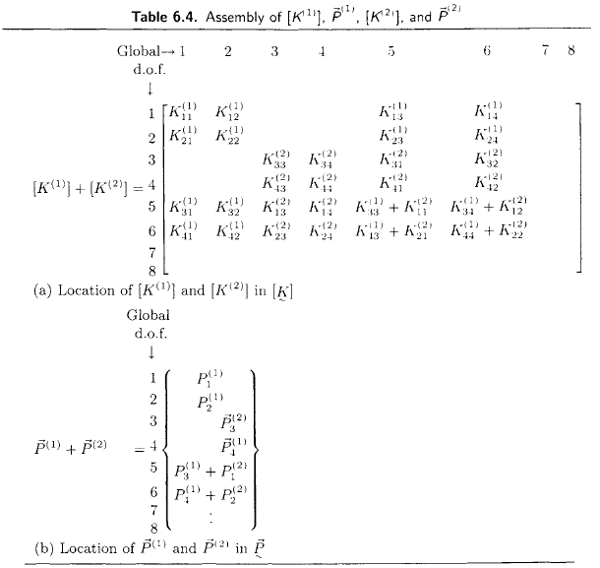
2
Assembly of elements [K⁽¹⁾] & P⁽¹⁾, [K⁽²⁾] & P⁽²⁾

Slide 25
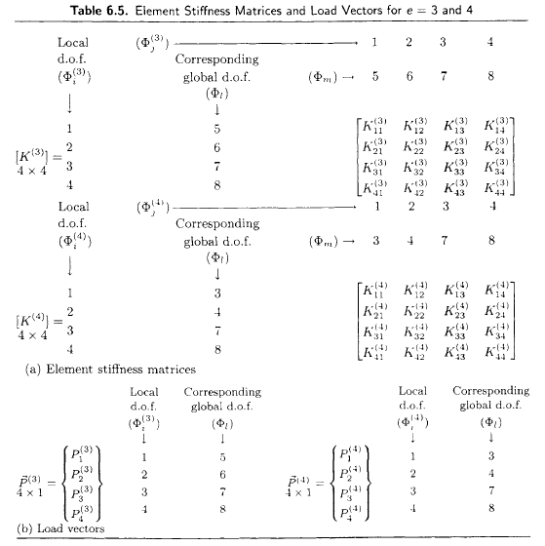
Stiffness Matrix and Load Vector of Elements 3 & 4

Slide 26
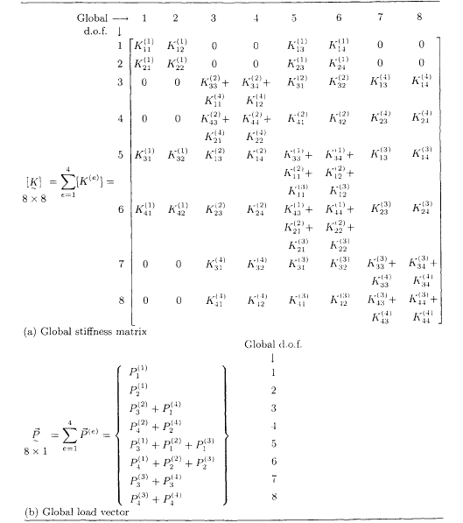
Assembled stiffness matrix and load vector

Slide 27
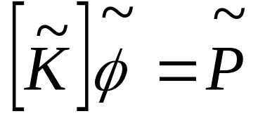

Incorporation of boundary conditions
- After assembling the element matrix and vectors, the overall or system equations of the entire domain can be written as:
Solution for cannot be obtained unless boundary conditions are applied. They reflect the known values for certain primary unknowns. Imposing the boundary conditions modifies the global equations.

Slide 28
Numerical Solution of Finite Element Equations
- Refer Text (pp. 230 ~ ), FE procedures, K.J. Bathe, Chapter 8.
- Gaussian Elimination Method (most commonly used).
- GeoSlope uses another additional method (pp. pdf-392~3).
- Computer Implementation
- Refer Text (pp. 215 ~ )
- Refer Website: (http://books.elsevier.com/companions/075067072X/)

Slide 29
Selected FEM Resources on the Internet
http://www.engineeringzones.com - A website created to educate people in the latest engineering technologies, manufacturing techniques and software tools. Excellent FEM links, including links to all commercial providers of FEM software.
http://www.comco.com/feaworld/feaworld.html - Extensive FEM links, categorized by analysis type (mechanical, fluids, electromagnetic, etc.)
http://femur.wpi.edu - Extensive collection of elementary and advanced material relating to the FEM.
http://www.engr.usask.ca/%7Emacphed/finite/fe_resources/fe_resources.html - Lists many public domain and shareware programs.
http://sog1.me.qub.ac.uk/dermot/ferg/ferg.html#Finite - Home page of the the Finite Element Research Group at The Queen's University of Belfast. Excellent set of FEM links.
http://www.tenlinks.com/cae/ - Hundreds of links to useful and interesting CAE cited, including FEM, CAE, free software, and career information.
http://www.geocities.com/SiliconValley/5978/fea.html - Extensive FEM links.
http://www.nafems.org/ - National Agency for Finite Element Methods and Standards (NAFEMS).

